Slide 1
US ImmigratioN Analysis
UCI Data Boot Camp Project 2: Group 6 Said Pakyari, Max Oteng, Trevor Towers, Scott Leslie

Slide 2
Goals
Design and Deploy Visualizations that provide insight into Immigration profile of the US
Analyze Immigration across Demographics
Geographically Map Immigration from the World to locations in the US
Perform analysis to describe the Immigration landscape
Provide Conclusions and Recommendations
Notes:
0.5 min

Slide 3
Today’s Agenda
Data Sources/Preparation
Scott
ETL/Webify Data
Saeed
Visualization Features and Functions
Trevor
Analysis
Max
Notes:
0.5 min

Slide 4


DaTA SouRCES*
Migration Policy Institute
Immigration Population by Birth Region/Demographic
Age, Education, Income and Job Type (Sample after merging/cleaning)
Department of Homeland Security
Immigration Population by County from Country (Sample after merging/cleaning) 2007-2018
960,000 Rows after merging, 368,000 after cleanup
Homeland
Security
* Not Including the myriad of ones we didn’t use!
Notes:
1 mins

Slide 5
ETL/Webify Data (max)
ETL
Clean/delete rows and columns
Normalize to standard geographical data definitions (US and International Regions)
Join to Latitude and Longitudes
Create Postgres data structures
Ingest/map into Postgres
Prepare for visualizations
Run calculations to make the data “visualization friendly”
Setup and populate Flask Routes (some of our routes below)
/api/v1.0/migration_data/(demography)[age\education\median_income\income\occupation] /api/v1.0/immigrants_by_county/(countries or regions)/(years)/(top) /api/v1.0/immigrants_by_state/(countries or regions)/(years)/(top) /api/v1.0/diversity_by_state/(locations)/(years)/(top)
Notes:
1 min

Slide 6
Visualizations
Bar Charts
What we have
What they Show
Pie Charts
What we have
What they Show
Bubble Map
What we have
What they Show
Notes:
1.5 min

Slide 7
Demonstration (Max)
A Bubble Map : Flow
Interactive Bar Charts: Demographic Profiles of Immigrations
Interactive Pie Charts: Diversity of nationality
Notes:
3 mins

Slide 8
Analysis of flow and demographic profiles of immigrants in us
What the visualizations tell us
1. Settlement:
Preferred States: Most settle in California, New York and Florida
Preferred Counties: Los Angeles (CA), Miami-Dade (FL), Cook County(IL), King (WA)
Most widely distributed: Central Asians and Sub-Saharan Africans
Demonstration
Where immigrants from Ghana settle
Notes:
2 min

Slide 9
Demonstration: settlement by county

Slide 10
Demonstration: immigrants from ghana

Slide 11
Analysis of flow and demographic profiles of immigrants in us
What the visualizations tell us
2. Age Demographics:
Most immigrants from Sub Saharan Africa and Asia (Central and South) tend to be younger < 20 yrs
Immigrants from Europe and Canada tend to be relatively older > 20 yrs

Slide 12
Analysis of flow and demographic profiles of immigrants in us
Notes:
1 min

Slide 13
Analysis of flow and demographic profiles of immigrants in us
What do the visualizations tell us
3. Education attainment:
Immigrants tend to have higher education (Bachelor degree and higher) than natural born Americans
South Asian Immigrants tend to have more advanced degrees
Immigrants from Mexico tend to have 2-year college education or lower.

Slide 14
Analysis of flow and demographic profiles of immigrants in us
Notes:
1 min

Slide 15
Analysis of flow and demographic profiles of immigrants in us
What the visualizations tell us
4. Income Demographics
Immigrants tend to have higher education (Bachelor degree and higher) than natural born Americans
South Asian Immigrants tend to have more advanced degrees
Immigrants from Mexico tend to have 2-year college education or lower.

Slide 16
Analysis of flow and demographic profiles of immigrants in us
Notes:
1 min

Slide 17
Analysis of flow and demographic profiles of immigrants in us
What the visualizations tell us
5. Median income:
Majority of immigrants earn more than $48K
About half of Mexican immigrants earn less than $48K
A little more than 40% of immigrants from South Asia earn more than $125k+

Slide 18
Analysis of flow and demographic profiles of immigrants in us

Slide 19
Analysis of flow and demographic profiles of immigrants in us
What the visualizations tell us
5. Job type:
Immigrants from South Asia: Management, Science
Immigrants from Mexico and Central America: Farming, Food services, Cleaning and Transportation
Immigrants from Sub Saharan Africa: Healthcare and Transportation

Slide 20
Analysis of flow and demographic profiles of immigrants in us
Notes:
1 min

Slide 21
Analysis of flow and demographic profiles of immigrants in us
What the visualizations tell us
6. Diversity in Nationality:
US: 14% from Mexico; [top 3: Mexico, China, India]
CA: 20% from Mexico; [top 3: Mexico, China, Philippines]
IL: 24% from Mexico; [top 3: Mexico, India, Poland]
NY/NJ: 16% from Dominican Rep; [top 3: Dominican Rep, China, India]
FL: 16% from China; [top 3 are China, Columbia, Venezuela]

Slide 22
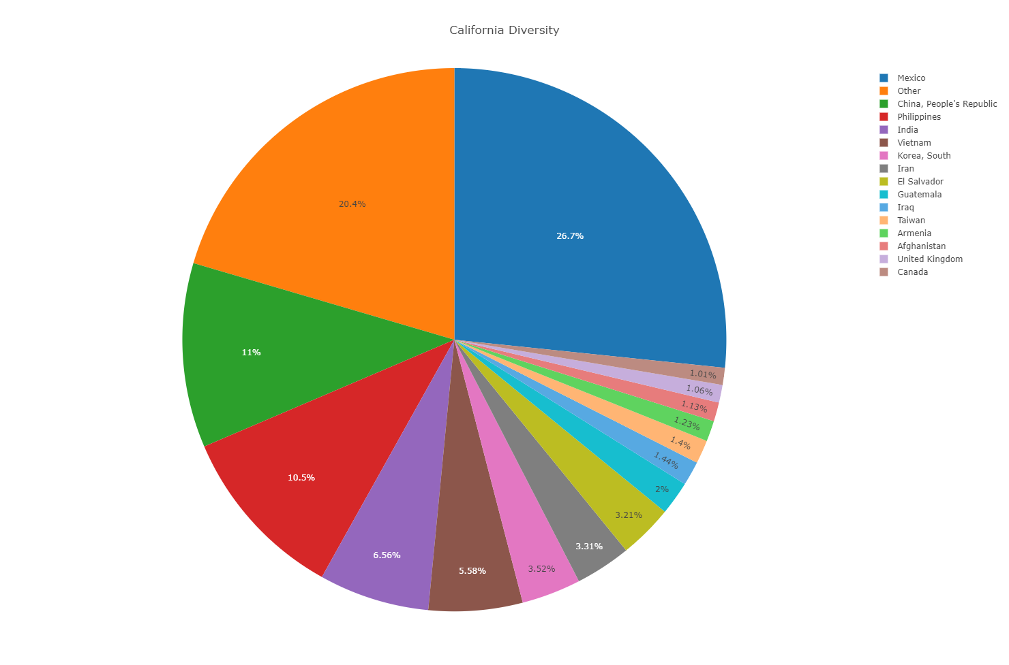
Analysis of flow and demographic profiles of immigrants in us

Slide 23
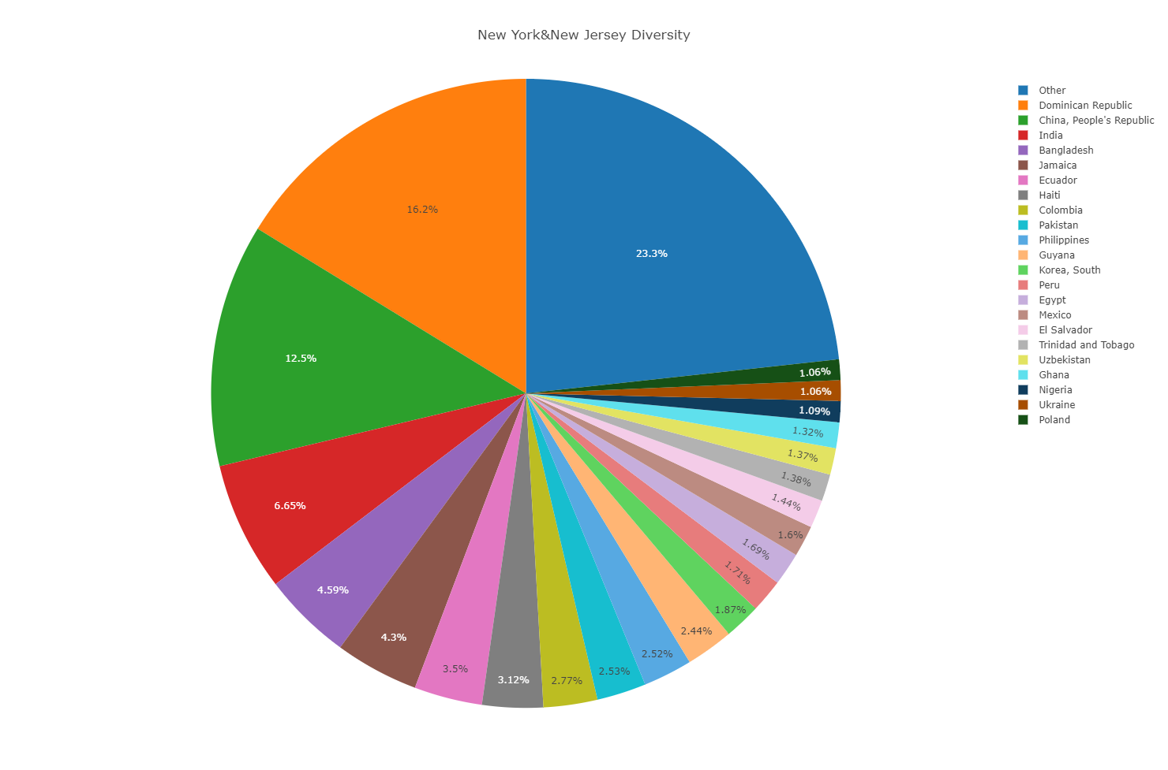
Analysis of flow and demographic profiles of immigrants in us

Slide 24
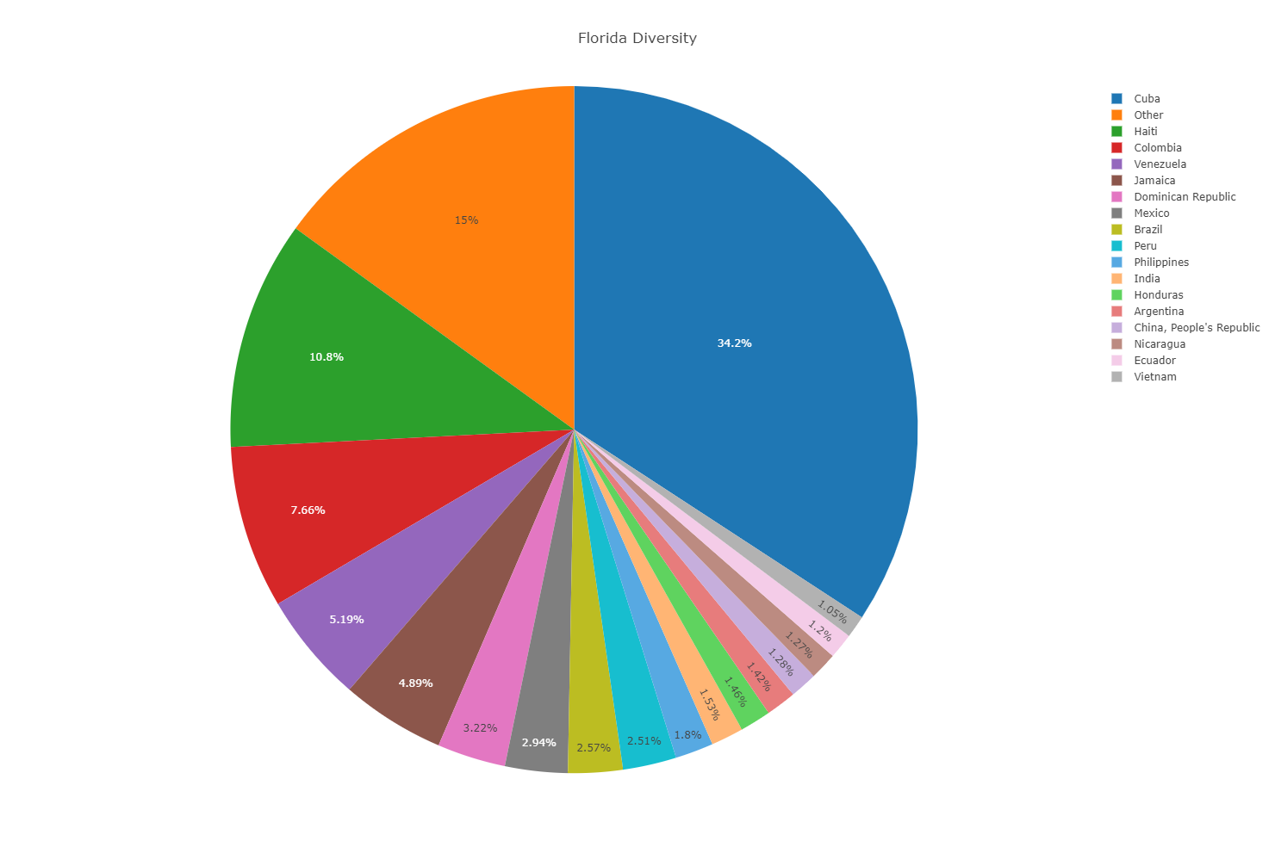
Analysis of flow and demographic profiles of immigrants in us

Slide 25
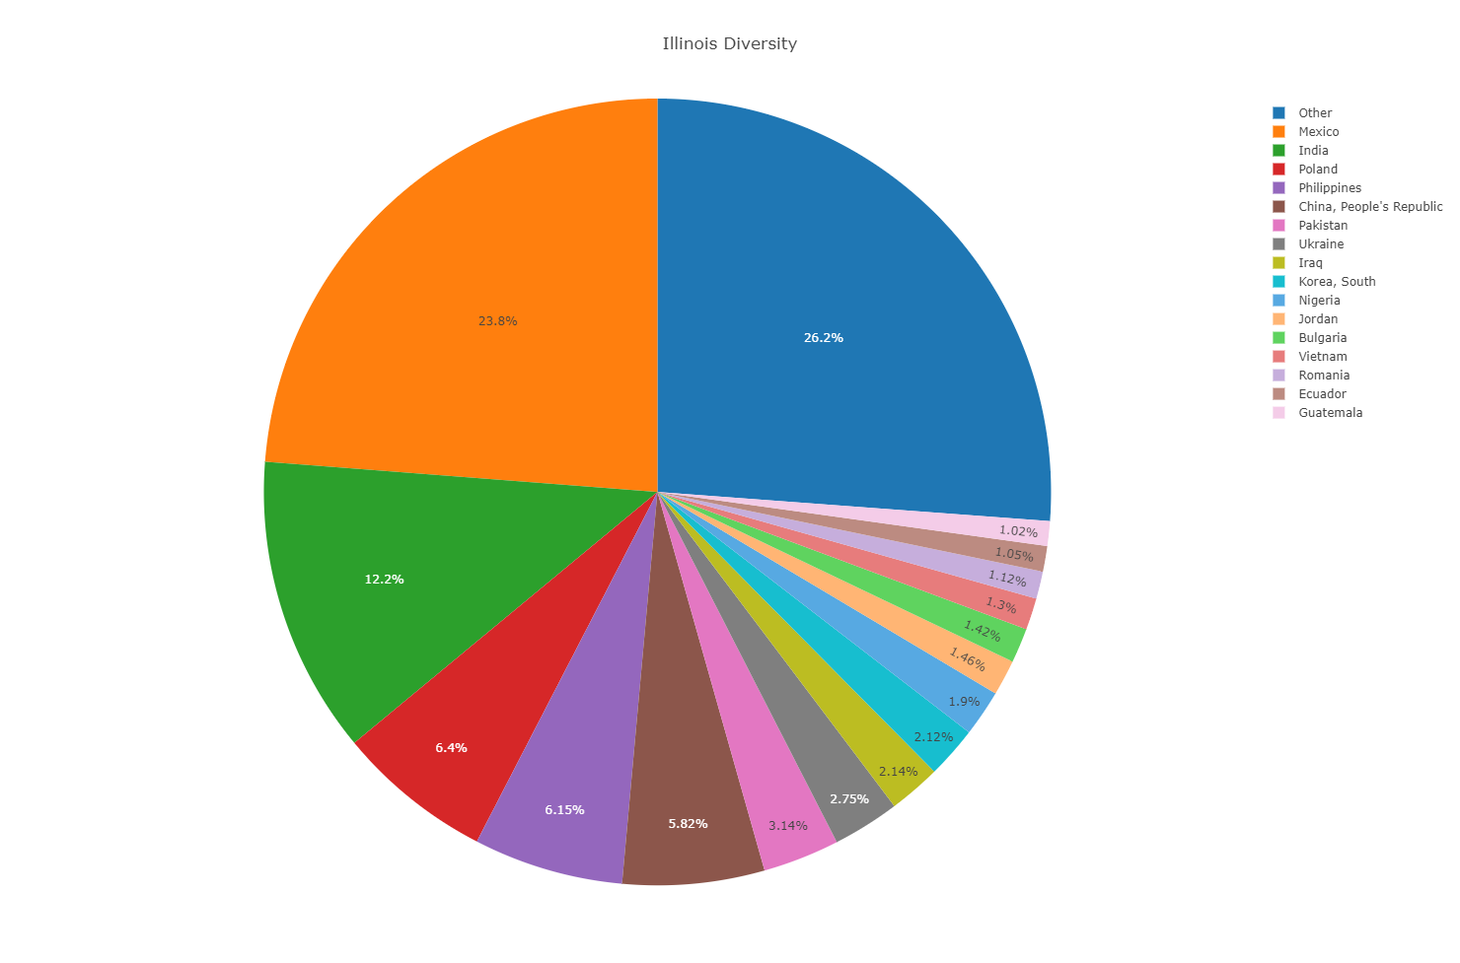
Analysis of flow and demographic profiles of immigrants in us

Slide 26
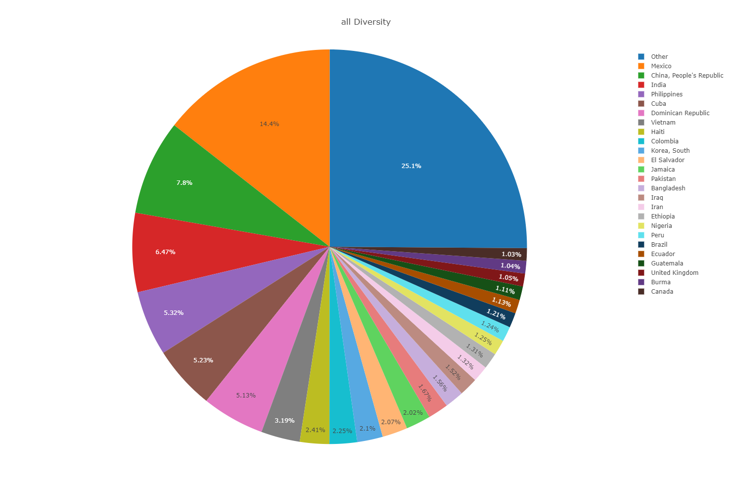

Slide 27
Conclusions
What we did:
Analyze the flow and selected demographic profiles of immigration to the US
Approach:
Interactive visualizations: Bubble Map, Bar Charts and Pie Charts
Tools and techniques: Javascript, Flask Alchemy, PostgreS, D3, Leaflet
Future project
Add heat map to bubble chart
Beautify the website
Advanced interactivity of our visual charts.
Notes:
1 min

